Slide 1
PC Data Conversion Gosu
Chennai, July 2017

Slide 2
Contents
Flow of Data Migration
Data Migration
Base entities provided by Guidewire
Gosu control flow
Populator and Base Entity Populator, GX Models
Batch Process and XML execution
Data Migration table
Explanation of XML elements
Properties Files
XSD
Common Errors

Slide 3
Flow of Data Migration
Legacy
GATE1
FTP
GATE2
SOURCE STAGING
GATE3
PCSTAGING
GATE4
POLICY LOAD
GATE5
PC

Slide 4
Data Migration
Data Migration is a process of transforming data from Source System(Legacy) to Policy Center by applying transformation and Cleansing Rules.
Once the Legacy data is moved to Policy Center via Renewal Transaction then going forward all the transaction for that policy will be handled in Policy Center retiring the Legacy system.
Guidewire uses a Accelerator to do this transfer of data to Load data into Policy Center.
This Accelerator in turn functions with the help of GX Models, Populators, Entities, Classes and Interfaces.

Slide 5
Gosu Control Flow

Slide 6
Control Flow
Work Queue Base
Migration Worker
(Extends)
CustomizedMigration Worker
(Extends)
Data Migration Process
Abstract Migration Process
(Extends)
(Execute Migration Process)
Customized Transaction API
Customized Transaction Container
(Extends)
Base Entity Populator
Account API
Submission API
Renewal API
Customized Entity Populator
Registry

Slide 7
Control Flow
From the Batch Process UI, CustomizedMigrationWorker class is called, it extends Migration worker in turn it extends WorkQueueBase.
In MigrationWorker, DataMigrationProcess class object is created where executeMigration() method is called.
DataMigrationProcess class extends AbstractMigrationProcess.
On calling executeMigration() method, the payload is processed and the TransactionAPI is set using CustomizedTransactionContainer which extends CustomizedTransactionAPI.
The sending XML may be Account, Submission or Renewal and it enters the corresponding API.
In Registry class a set of entity processing entries are found which leads to corresponding populator classes.
If no populator class is defined for a particular entity then BaseEntityPopulator takes care for the population of values.

Slide 8
GX Models

Slide 9
GX Models
GX model is XML standard being followed by Guidewire.
GX Model can be created for entities only, with the extension of .gx
Every entity can have a GX Model(it also can have more than one in a different package).
It will have all the columns defined in the GX including foreign key , Array keys, type list.
Additional to the entities columns, derived values can also be defined here, but it will not be saved to database. It is mainly for some calculations.
Using the GX models XSD’s are framed and which is given to Informatica team to frame or structure the XML.
The elements in the incoming XML’s are processed using GX models(like a kind of validating the XML structure).
Once it is successfully validated then the control is passed to Populator.

Slide 10
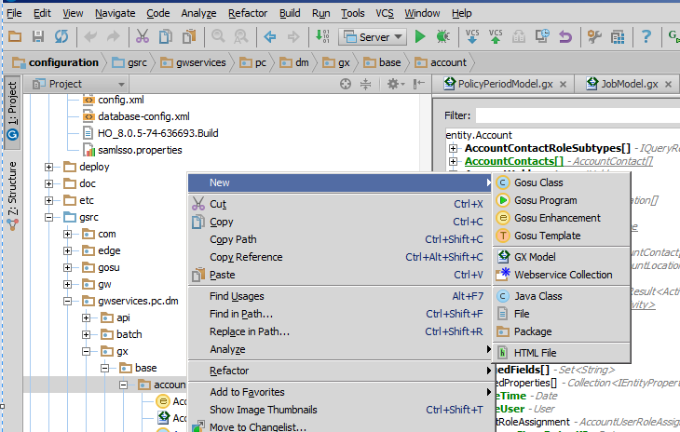
Creating a GX Model
Right click on the Folder and New-> GX Model

Slide 11
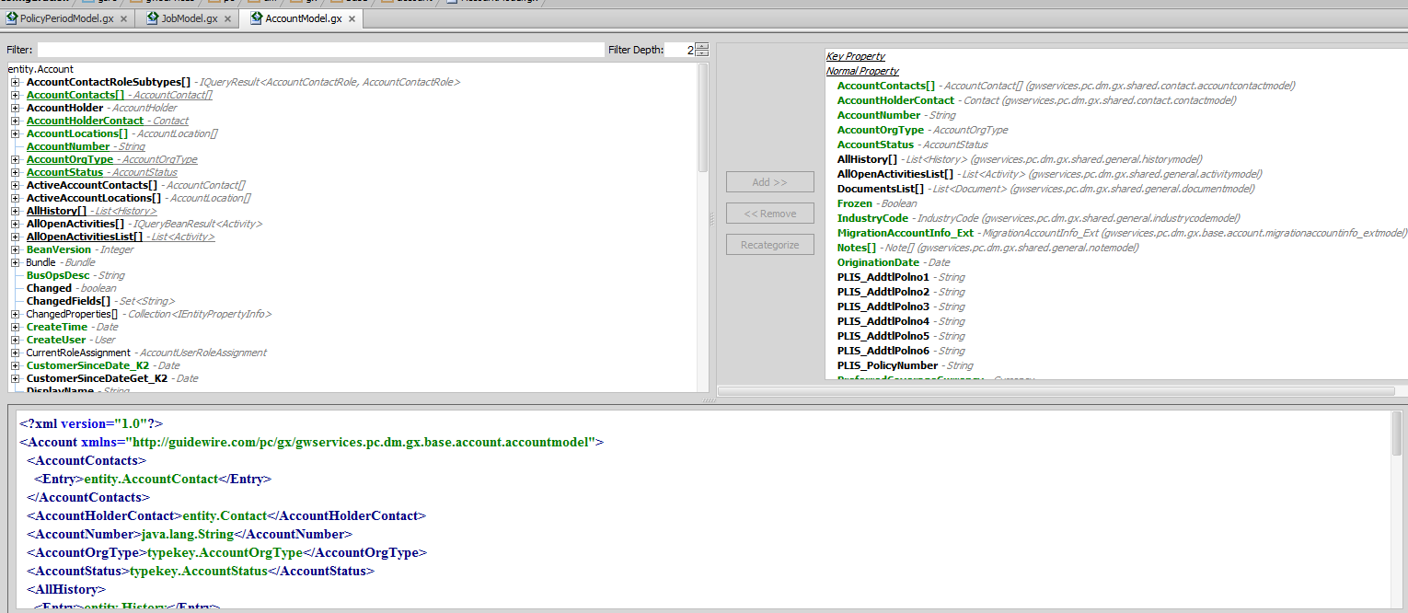
Sample GX Model
Below is the sample GX Model: Left pane holds, account entity along with its columns and its derived properties
Right Pane holds the columns needs to be added to be part of Conversion Loading(which also means the non-added column will not populated).

Slide 12
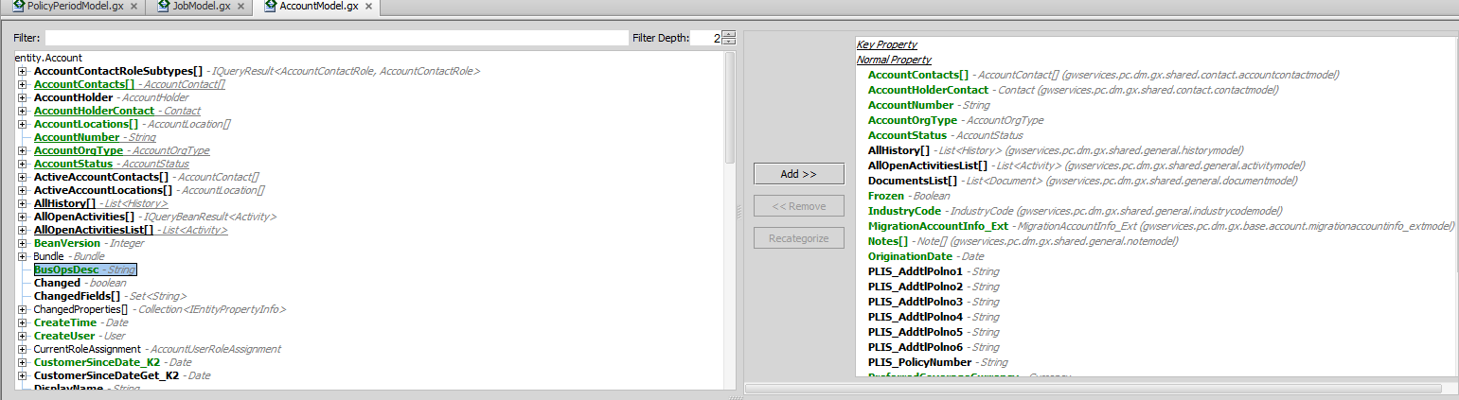
Add or Remove Values to GX Model
To add value to the GX Model, Select the particular column and click on add button in the middle pane.
If the selected column is not added then the Add button will be highlighted.

Slide 13
POPULATORS

Slide 14
Populator
Populator are being used as a ferry between GX Models and Database(PC Entities).
Guidewire itself provides a default populators called BaseEntityPopulator.
But still we can create our own populator if necessary.
Unlike GX Models during creation Populator doesn’t require or bound to specific GX Models or entity.
All the populator are need to be registered in the Registry.gs file.

Slide 15
Base Entity Populator
Populator are used to populate the values from the XML to Entities.
Base Entity Populator is the base class use to create the data in PC by using the XML.
All other Populator should extend BaseEntityPopulaor, provided that populator must be associated with a solid entity in the DB. If not this class cannot be extended.
Example CoveragePopulator Since Coverage doesn’t have a standalone entity for it is always associated with Coverable entity for this Base entity populator can be extended.
This class should be extended by all other populators .
The child populators can use BaseentityPopulator default creation and population by calling super.methodName() .

Slide 16
Cont…
These five methods are like thumb rules for Data migration flow.
Function | Description | Base Functionality
Initialize | Initialize | Locates the associates entity by examining the XML model type. Also determines if the model is effective dated and has a "BasedOn" public ID configured.
findEntity | Locate an existing entity return NULL if its not found | Looks for an entity by publicID, checks for any one to one relationship, and finally queries by current publicID
create | Creates an entity if findEntity returns NULL | Creates an entity using primary contructor.
populate | Populates the entity | Populates standards fields. Will also populates subtypes fields.
finish | Apply some finishing logic to completed entity after adding into the parent. | Not implemented in base entity populator.

Slide 17
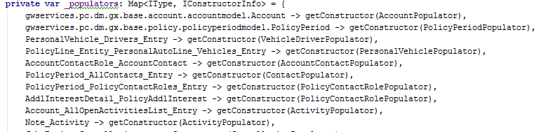
Registry
Registry is used to register the populators
In Registry we have a private Map collection variable.
All the populators along with its Key and Value pair are being registered here.
The Key shows the traverse of the variable in XML and Value shows the object to be used.
One populator can be used in multiple XML paths in the above example PolicyContactRolePopulator.

Slide 18
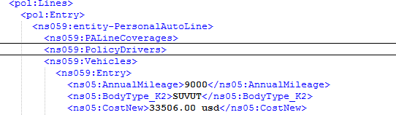
Example
In the Previous screen shot , the line
Key : PolicyLine_Entity_PersonalAutoLine_Vehicles_Entry
Value : PersonalVehiclePopulator.
The below XML shows the path of how the Key is being framed.
the Value in the map states which Populator needs to be used.

Slide 19
Cont…
doNotPopulate is a List variable. If any value doesn’t need to be created will be added here example activity pattern for which only look up is needed .
If not Registered here then payloads will fail saying No_Backing_Entity error.

Slide 20
Batch Process and XML execution from Migration Tables
XML are created and inserted into Data migration Table(Policy_migration) with the help Staging Tables.
From the PC UI the batch jobs are getting triggered. The batch job picks the XML with Status null and starts its process.
First identification about the XML should be either it is a Account or Policy XML from the Payload Type column.
Then all the necessary Populators which is required is populated.
This Populators in turn calls the GX models and assigns the XML value in the appropriate entity columns.
If the run is successful, Then the XML is committed to respective pc tables and the status of the Data Migration table is acknowledged with ‘COMPLETE’.
If the XML’s are error out then it is not committed to DB and Status of the Data Migration Table is acknowledged with ‘ERROR’.

Slide 21
Data Migration Table
All the legacy data is well formed in Guidewire PC entities form and inserted into Data migration table by the ETL team.
The important columns of the DM table are ID, Status, Batch Id, Sequence_number, Payload_type, Account_number, policy_number, Application ID, Worker Id , Error _code, Error_message and Payload.
Status can be any of one the below:
Status | Description
Null | Initial status when the Payload is inserted by the ETL team
Complete | Gosu batch job takes this null records and try to commit, it to PC DB it is successful then the status will be complete.
Error | Due to some error if the records is not committed, then the status will be error.
Delayed | If any of the transactions fails then its subsequent transaction will lead to Delayed status.

Slide 22
Cont…
Batch Id – will be a same value for one batch for all the records.
Sequence numbers – As the Name says it determines the sequential execution of the records. Account and related policies should have the sequence numbers. Else the payloads fails.
Payload_type – If the Payload is Account then the Payload type will be Account else if it is policy then payload type will be the Job of the policy like submission or renewal.
Account_Number will be having the account number.
Policy_number will be having Policy number.
Application Id – When the processing of the payload completes, then Account or Job number will be stored.
Worker Id – System or Server or thread which picks the payload for execution.
Error_code – when the records are error out then the type of error is captured here some type are General, Unparaseable, Missing account etc.
Sequence Number , Id and Batch Id combined is the primary key for this table.

Slide 23
Explanation of XML Elements -- Account XML.
XML are framed based on the GW entity relationship in parent and child format.
We will explain with the example of Account entity.
All of Account entity columns including array keys, foreign keys should be present(provided the same should be in GX Model) .
Each of the foreign keys and array keys in turn will be mapped in a parent and child relationship. Since Array keys may have more than one value then each of its children should be placed between <entry></entry>.
For an XML to successfully execute in Policy Center.
All the admin data need to be loaded (like Producer code).
Type list values in XML need to be in sync with PC type list.
There should not be duplicate Account (Which means already loaded).

Slide 24
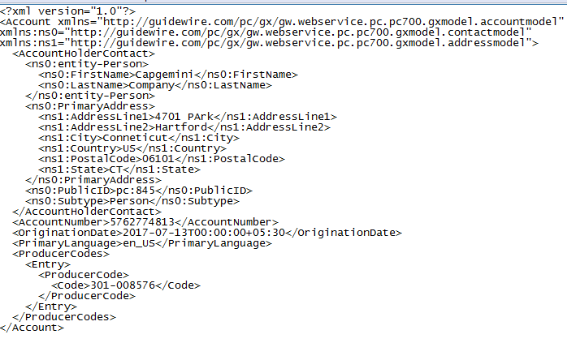
Sample XML Structure

Slide 25
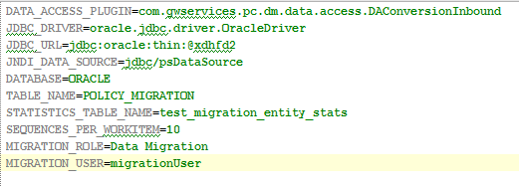
Properties File
Properties file used to connect the Policy Center to Vendor Database
It mainly consist of JDBC or ODBC URL.
DataSource : Datasource created for Converted Policies.
Table name: Data to exetute or picked Via batch number.
Sequence_Per_workiteam : Number of sequences to be processed by the instances

Slide 26
XSD Schema
XSD are framed with the help of GX models and given to ETL team.
The XSD is the format of PC entities relationship, we have two types of XSD one is Account and other one is Policy.
In this XSD format we will receive an XML in Migration table which when loaded via batch process gets successfully loaded into Policy Center.

Slide 27
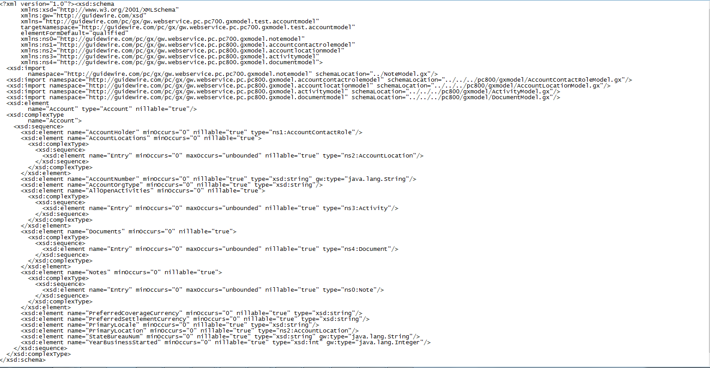
XSD Schema

Slide 28
Common Errors
Error | Error Reason
Missing_Account | When account is not loaded but we are trying to load a Policy.
NO_Backing_Entity | When there is a wrong path for the populator is being registered in the Registry.
DB_Null_Constrain | When a Null safe false value is ont being passed.
Duplicate_Exception | When a same public id is being passed.
Specific Exception : Producer Code Exception | Producer Code is missing

Slide 29
Base Entities Provided for Data Migration
Entities for DM
MigrationAccountInfo_EXT
MigrationJobInfo_EXT
MigrationEntityID_EXT
MigrationLegayPolicy_EXT
MigraitonPolicyInfo_EXT
MigrationWorkConfigParameter_EXT
MigrationWorkConfig_EXT
MigrationPayloadType_EXT
The first three entities have a special property called Auto-Deletion which payloads will be automatically removed once they are processed.

